Slide 1
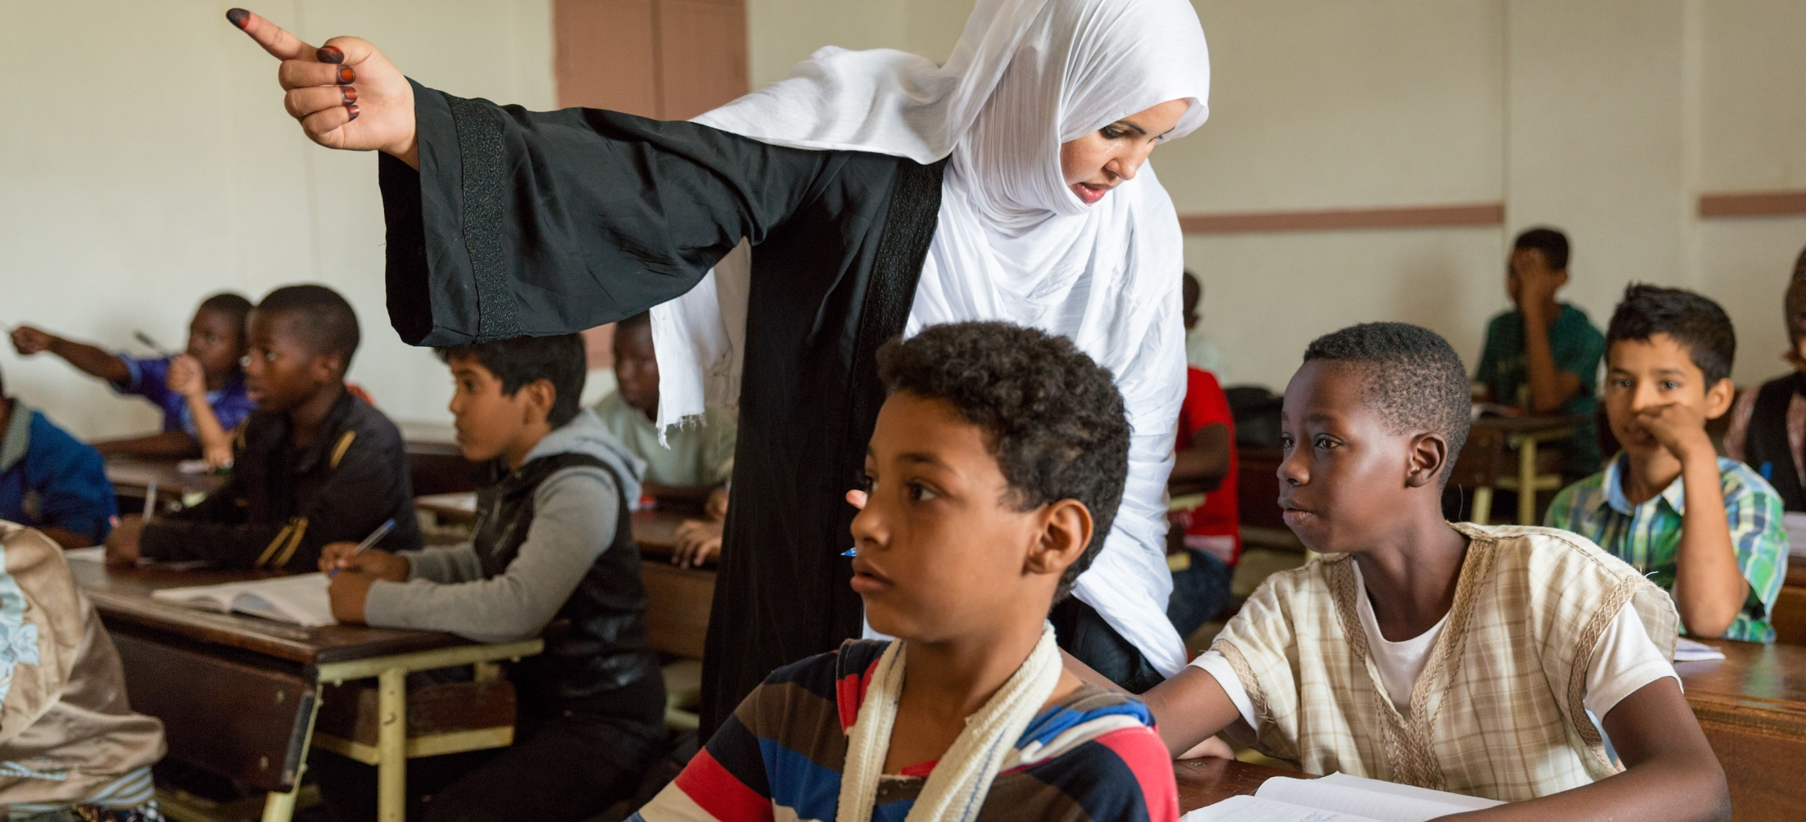



MODULE 07
Education’s Role in Preventing and Countering Violent Extremism
Global Partnership for Education - GPE/CC BY-NC-ND 2.0

Slide 2
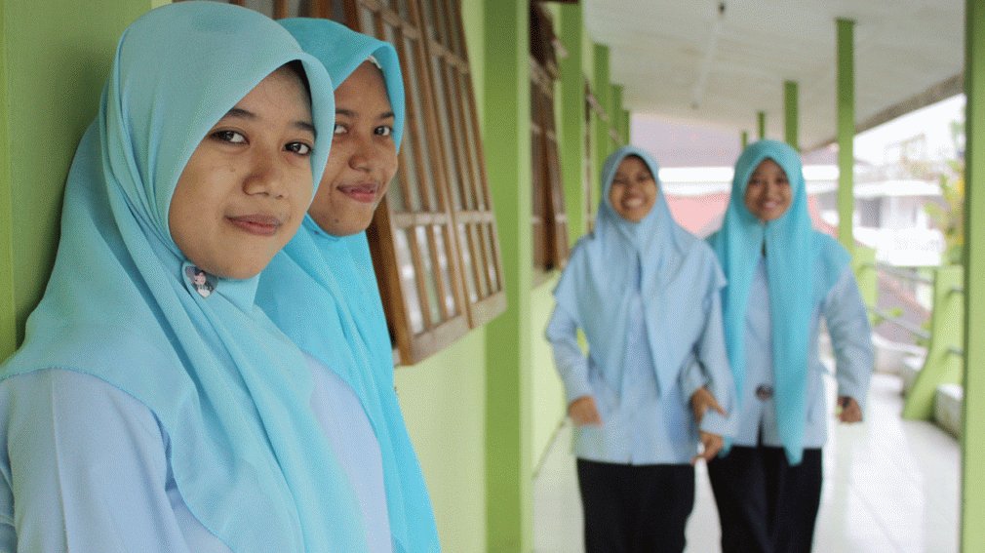
MODULE 07 | Education’s Role in Preventing and Countering Violent Extremism
DO YOU AGREE WITH THE FOLLOWING STATEMENT?
Education cannot prevent an individual from committing a violent act in the name of a violent extremist ideology.
02

Slide 3
MODULE 07 | Education’s Role in Preventing and Countering Violent Extremism
What is the role of education in building resilience to violent extremism?
create the conditions that make it difficult for violent extremist ideologies and acts to spread
education policies can ensure that places of learning do not become a breeding ground for violent extremism
ensure that educational contents and teaching/learning approaches develop learners’ resilience to violent extremism
create the conditions that build the defenses, within learners, against violent extremism and strengthen their commitment to non-violence and peace
03

Slide 4

MODULE 07 | Education’s Role in Preventing and Countering Violent Extremism
What skills and knowledge do we need to teach learners to be resilient to the appeal of violent extremism?
04

Slide 5
MODULE 07 | Education’s Role in Preventing and Countering Violent Extremism
Educational objectives to promote resilience
Information and communication
technology
Dealing with trauma and criticism
Intercultural and interreligious
awareness
Digital and critical literacy
Critical thinking skills
Communication skills
Vocational skills
Problem-solving skills
Social inclusion
Debate skills
Other skills
05

Slide 6
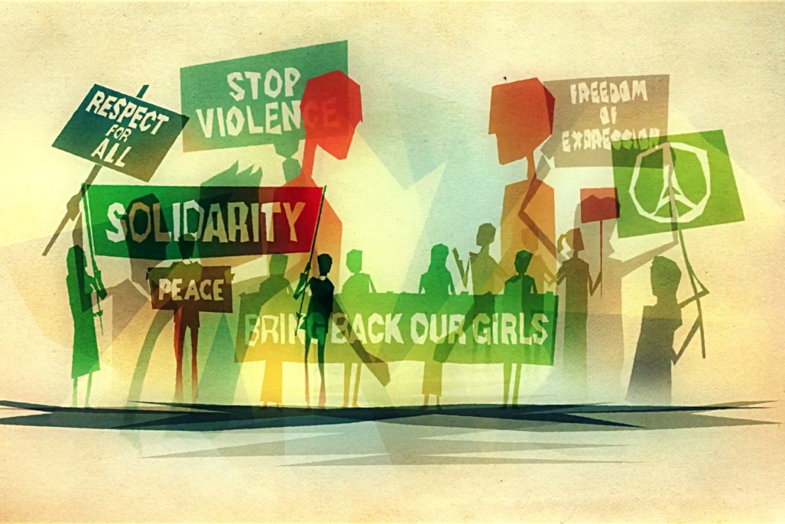

MODULE 07 | Education’s Role in Preventing and Countering Violent Extremism
VIDEO 14 | Global Citizenship Education to prevent violent extremism
By: UNESCO
Original Link:
https://youtu.be/nhwVKKPDm4A
Downloadable Link:
The video can be downloaded here.
Arabic Subtitles:
Advanced
(recommended for use with downloaded versions)
Basic
(recommended for use with YouTube)
Instructions on using these subtitles are
available here.
06

Slide 7
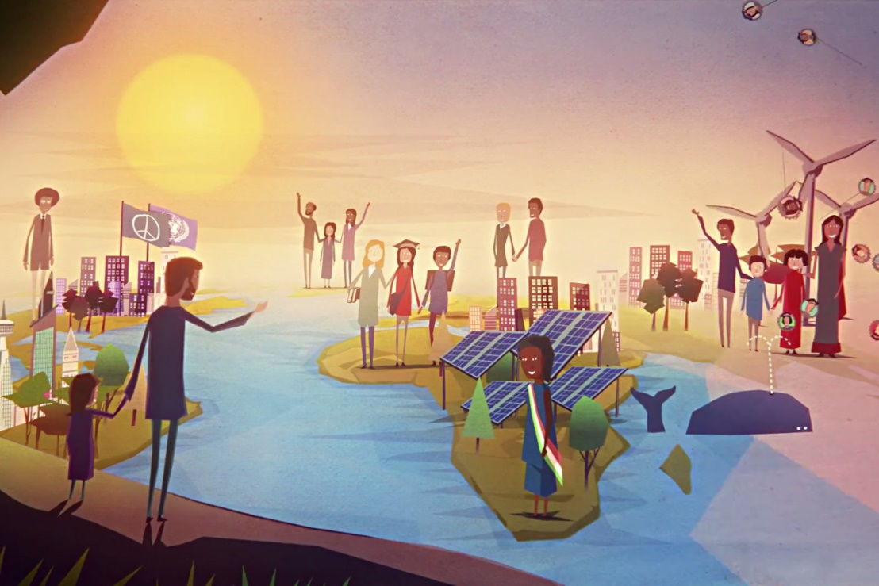
MODULE 07 | Education’s Role in Preventing and Countering Violent Extremism
VIDEO 15 | Learning to live together in peace through Global Citizenship Education
By: UNESCO
Original Link:
https://youtu.be/KuKzq9EDt-0
Downloadable Link:
The video can be downloaded here.
Arabic Subtitles:
Advanced
(recommended for use with downloaded versions)
Basic
(recommended for use with YouTube)
Instructions on using these subtitles are
available here.
07

Slide 8
MODULE 07 | Education’s Role in Preventing and Countering Violent Extremism
Other examples of preventing and countering violent extremism through education programs:
Active Citizens (British Council)
Media and Information Literacy (UNESCO)
Peace Education
Preventing and Countering Violent Extremism through Education curriculum (Hedayah and UNESCO)
World Heritage in Young Hands (UNESCO)
Beyond Bali Education Package (Bali Peace Park Association)
1001 Nights (Big Bad Boo)
08

Slide 9
MODULE 07 | Education’s Role in Preventing and Countering Violent Extremism
What are examples of formal and informal educational spaces?
FORMAL EDUCATIONAL SPACES:
Schools
Universities
Other educational institutions that offer degrees or certificates
INFORMAL EDUCATIONAL SPACES:
Clubs
Extracurricular activities
Special workshops
Community-based approaches
And more!
09

Slide 10
MODULE 07 | Education’s Role in Preventing and Countering Violent Extremism
Why might it be difficult to include these kinds of topics or curricula explored in the previous slides into the formal educational space?
10

Slide 11
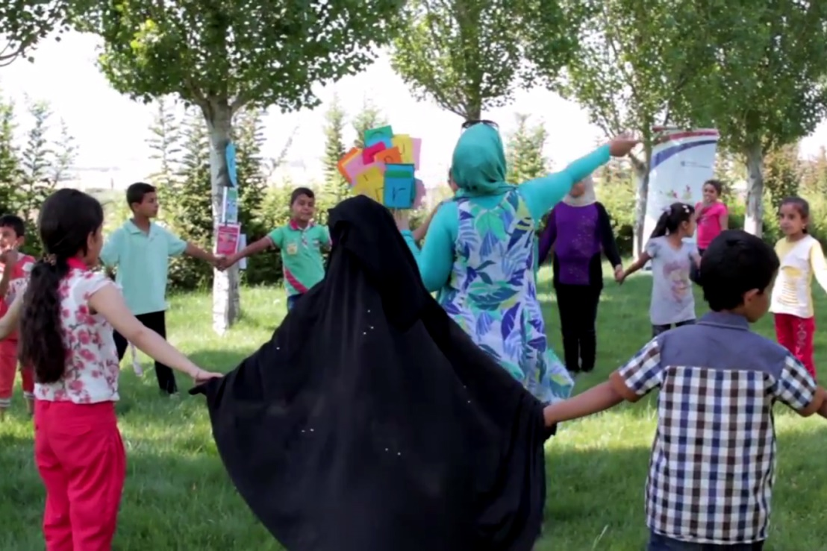
MODULE 07 | Education’s Role in Preventing and Countering Violent Extremism
VIDEO 16 | Rainbow of Hope collaborates with Eco Boys and Girls
By: Search for Common Ground
Original Link:
https://youtu.be/As_iailNRZ4
Downloadable Link:
The video can be downloaded here.
11

Slide 12
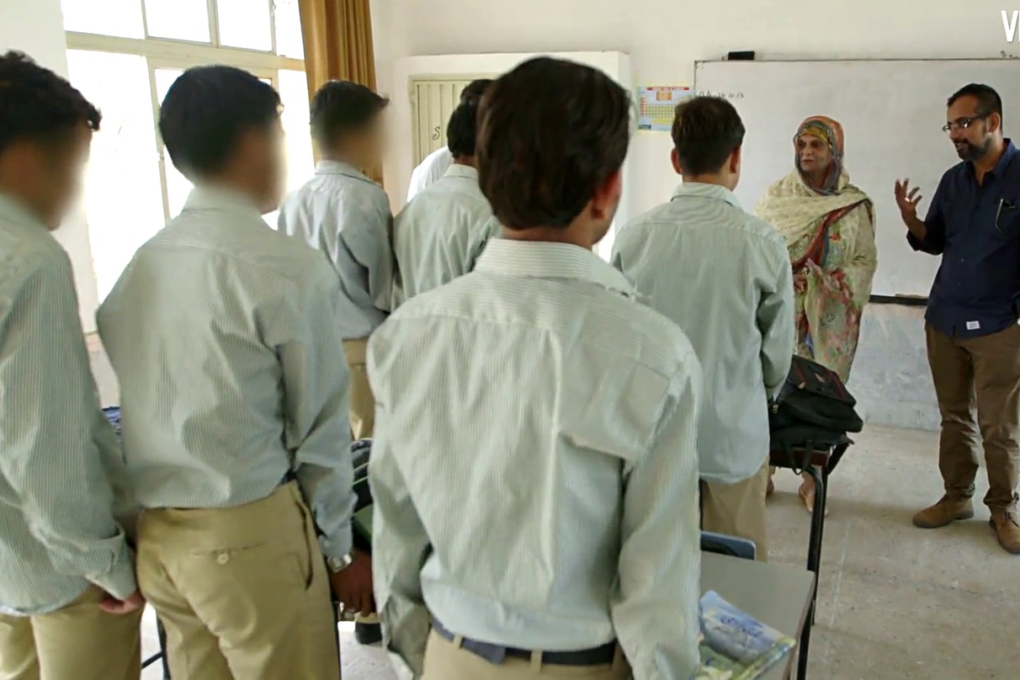
MODULE 07 | Education’s Role in Preventing and Countering Violent Extremism
VIDEO 17 | Terrorist Rehab School
By: Vice News
Original Link:
https://youtu.be/yUTIoVM2mxc
Arabic Subtitles:
Advanced
Basic
(recommended for use with YouTube)
Instructions on using these subtitles are
available here.
12

Slide 13
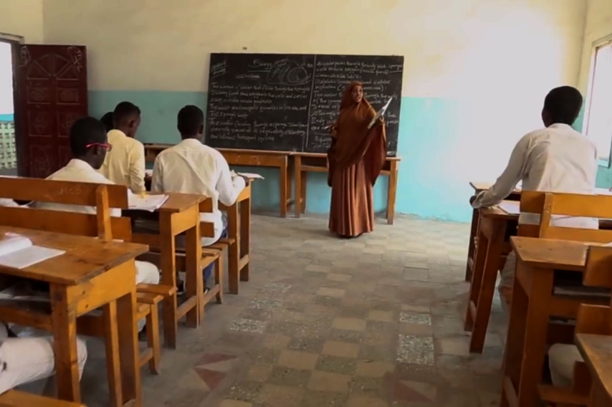
MODULE 07 | Education’s Role in Preventing and Countering Violent Extremism
VIDEO 18 | Somali Youth Learners Initiative
By: The United States Agency for International Development (USAID)
Original Link:
https://youtu.be/EPmKcfefwrI
Downloadable Link:
The video can be downloaded here.
Arabic Subtitles:
Advanced
(recommended for use with downloaded versions)
Basic
(recommended for use with YouTube)
Instructions on using these subtitles are
available here.
13

Slide 14
MODULE 07 | Education’s Role in Preventing and Countering Violent Extremism
What are some risks of implementing countering violent extremism projects or policies in educational spaces?
14

Slide 15
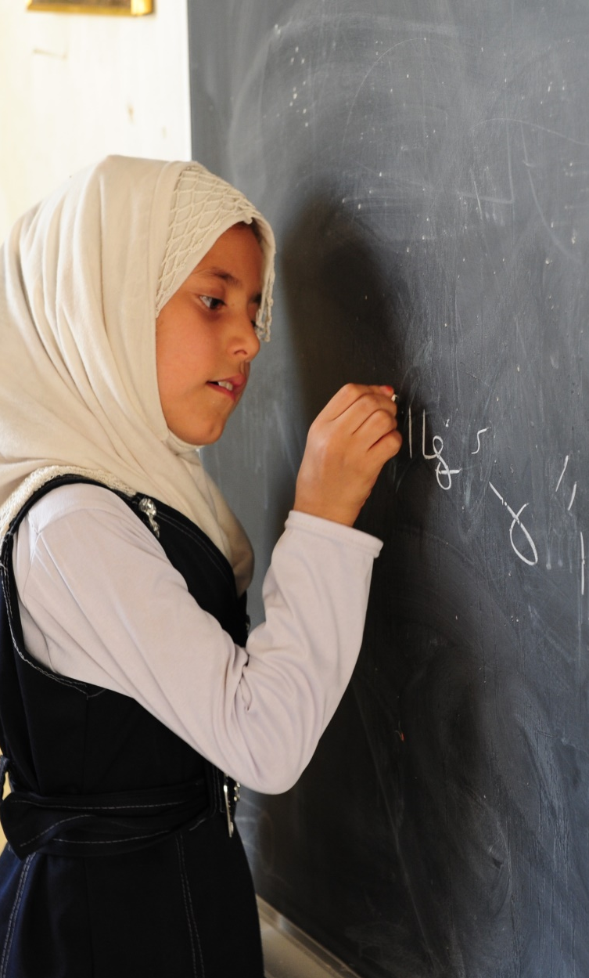
MODULE 07 | Education’s Role in Preventing and Countering Violent Extremism
Increasing risks by exposing youth to violent extremist ideas.
Teachers not having the proper support, tools,
and training.
Further marginalizing vulnerable students or polarizing classrooms.
15

Slide 16

MODULE 07 | Education’s Role in Preventing and Countering Violent Extremism
KEY TAKEWAYS
Countering violent extremism through education is not about “catching” violent extremists but about preventing and intervening in the radicalization process.
Educational spaces may create grievances that can drive violent extremism.
There are numerous educational resources that can be incorporated into countering violent extremism programs.
The selection of education initiatives for countering violent extremism should be guided by whether they work to address specific drivers of violent extremism in a particular context.
16

