Slide 1
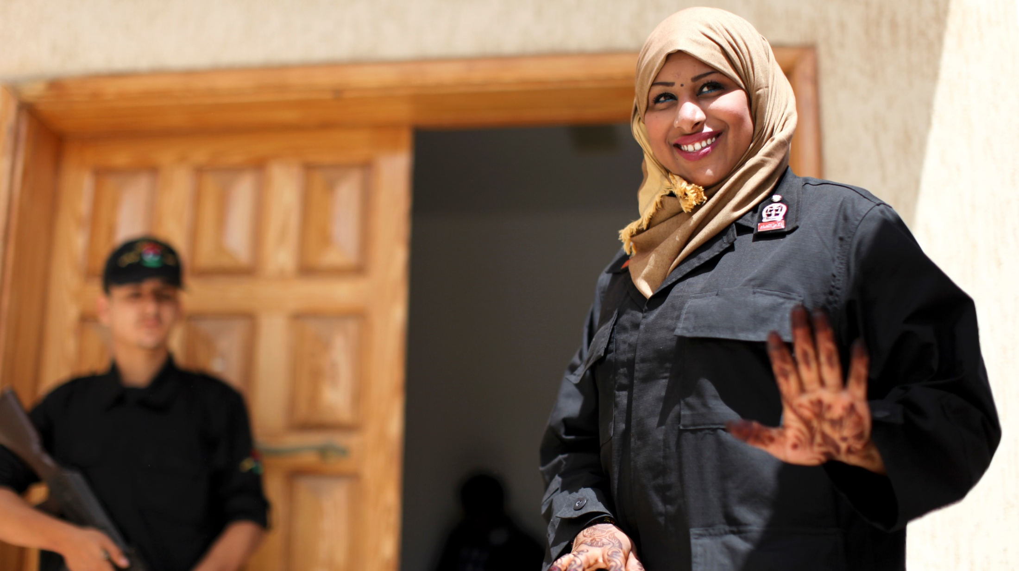



MODULE 05
Understanding Gender Dynamics to Radicalization, Violent Extremism and Engaging Women and Girls
UN Photo/Iason Foounten

Slide 2

MODULE 05 | Understanding Gender Dynamics to Radicalization, Violent Extremism and Engaging Women and Girls
REFLECTION QUESTIONS
How did you feel being part of Group 1 or 2?
How did you figure out the unspoken rules?
How did it feel when you were not able to complete the task successfully?
How did it feel for those in Group 1 to understand the rules and to exclude those from Group 2 when they did not understand the unspoken rules?
02

Slide 3
MODULE 05 | Understanding Gender Dynamics to Radicalization, Violent Extremism and Engaging Women and Girls
REFLECTION QUESTIONS
Did those in Group 2 try and help other members of their group to
figure out the rules?
Are there times when you have been in a similar situation, trying to
figure out social rules that you did not know, like when you traveled
to a new place? What happened when you returned home?
03

Slide 4

Gender refers to the socially constructed characteristics of women and men – such as norms, roles and relationships of and between groups of women and men. It varies from society to society and can be changed. While most people are born either male or female, they are taught appropriate norms and behaviors – including how they should interact with others of the same or opposite sex within households, communities and work places.
MODULE 05 | Understanding Gender Dynamics to Radicalization, Violent Extremism and Engaging Women and Girls
04

Slide 5

MODULE 05 | Understanding Gender Dynamics to Radicalization, Violent Extremism and Engaging Women and Girls
How important do you feel gender is for countering violent extremism? Why is that?
How important do you feel it is to engage women and girls in countering violent extremism?
05

Slide 6
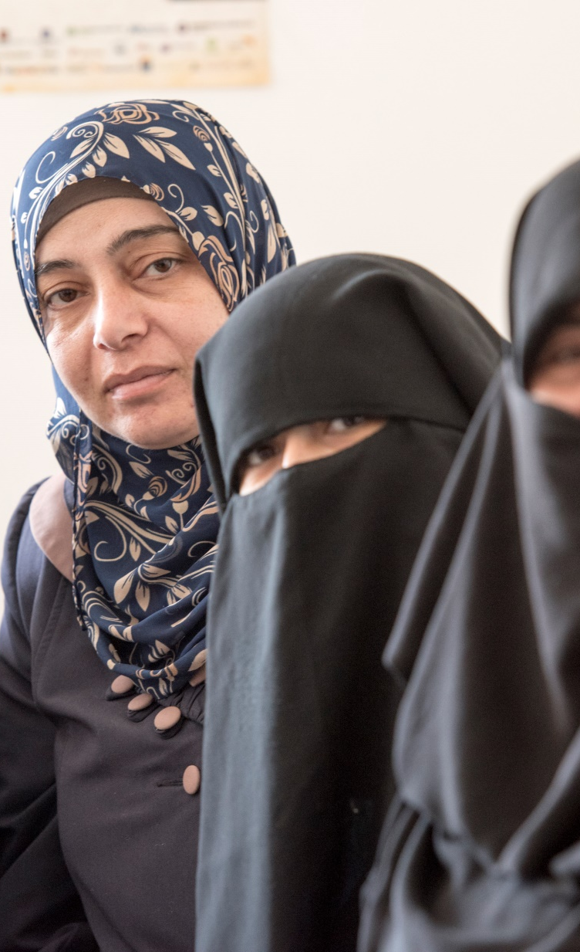
UN Photo/Mark Garten
MODULE 05 | Understanding Gender Dynamics to Radicalization, Violent Extremism and Engaging Women and Girls
Projects that incorporate gender:
are more effective, as we are able to design interventions that are specific to the unique ways that different people are drawn to violent extremism;
avoid ignoring the risks women and girls may have to the appeal of violent extremism; and
challenge the violent forms of masculinity and femininity that violent extremist groups promote and try to socialize their supporters and recruits into.
06

Slide 7
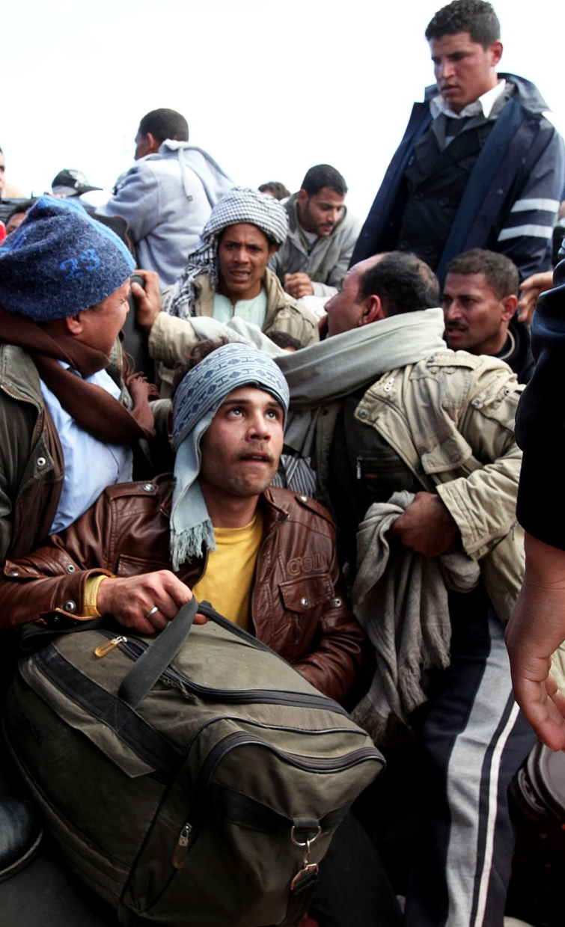
UN Photo/UNHCR/A Duclos
MODULE 05 | Understanding Gender Dynamics to Radicalization, Violent Extremism and Engaging Women and Girls
Common gender stereotypes about violent extremism:
Women are not recruited by violent extremist groups
Women only support violent extremism when they are coerced or because of connections to male violent extremists
Men take part in violent radicalism due to a personal desire to change their societies, while women have other reasons
Women do not commit violence in violent extremist groups
07

Slide 8
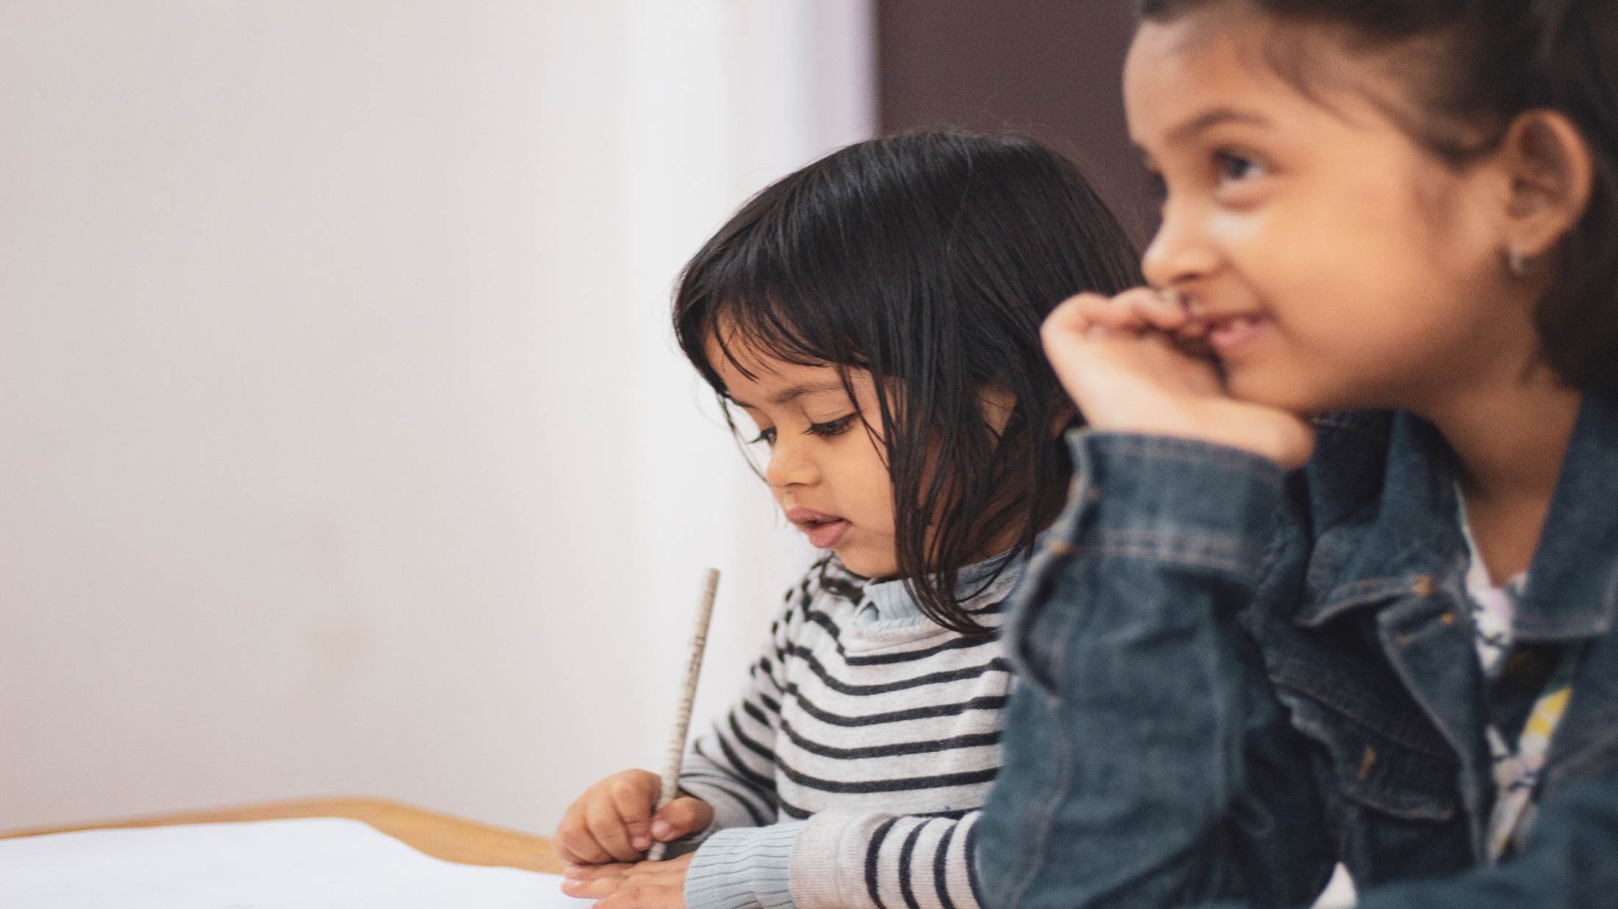
MODULE 05 | Understanding Gender Dynamics to Radicalization, Violent Extremism and Engaging Women and Girls
DO YOU AGREE WITH THE FOLLOWING STATEMENT?
Women and girls are not at risk of radicalization.
08

Slide 9
MODULE 05 | Understanding Gender Dynamics to Radicalization, Violent Extremism and Engaging Women and Girls
ISIL’s gendered strategy for women and girls:
Highlighted gender-specific push factors in women and girls’ home countries, such as politically subjugated and oppressed, economically poor, and unsafe because of the threat of sexual violence.
Made promises of wealth, stable livelihoods, romance, and the chance to support ISIL’s “state-building” project.
Offered a chance to seize control of their own lives and do something forbidden and exciting with the hopes of changing their own society or creating a new one.
09

Slide 10
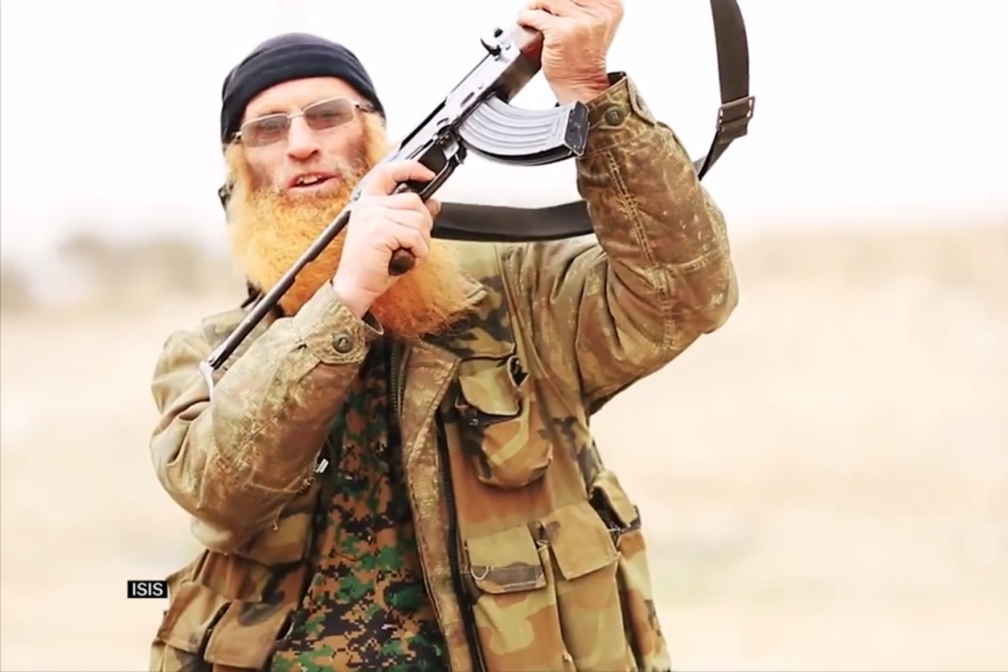

MODULE 05 | Understanding Gender Dynamics to Radicalization, Violent Extremism and Engaging Women and Girls
VIDEO 6 | ISIS videos are sickening. They’re also really effective.
By: Vox
Original Link:
https://youtu.be/18lf1kpBgRk
Arabic Subtitles:
Advanced
Basic
(recommended for use with YouTube)
Instructions on using these subtitles are
available here.
10

Slide 11

UN Photo/UNHCR/A Duclos
MODULE 05 | Understanding Gender Dynamics to Radicalization, Violent Extremism and Engaging Women and Girls
ISIL’s gendered strategy for men and boys:
ISIL called on men and boys to perform their traditional gender roles as “protectors” of women and children as “guardians of the faith and protectors of the land.”
ISIL also used women as a tool to recruit men, by promising them marriages with local and foreign women or captured women as sex slaves.
11

Slide 12
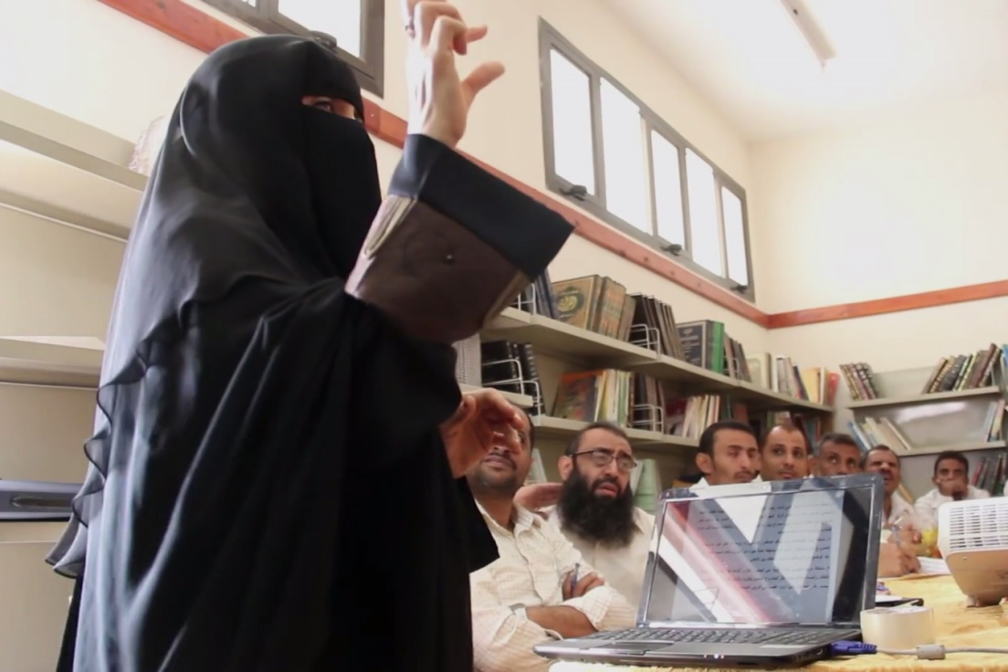
MODULE 05 | Understanding Gender Dynamics to Radicalization, Violent Extremism and Engaging Women and Girls
VIDEO 7 | Breaking the mold: Woman mediator challenges gender norms in Yemen
By: Search for Common Ground
Original Link:
https://youtu.be/gdDv4BBj-1c
Downloadable Link:
The video can be downloaded here.
Arabic Subtitles:
Advanced
(recommended for use with downloaded versions)
Basic
(recommended for use with YouTube)
Instructions on using these subtitles are
available here.
12

Slide 13
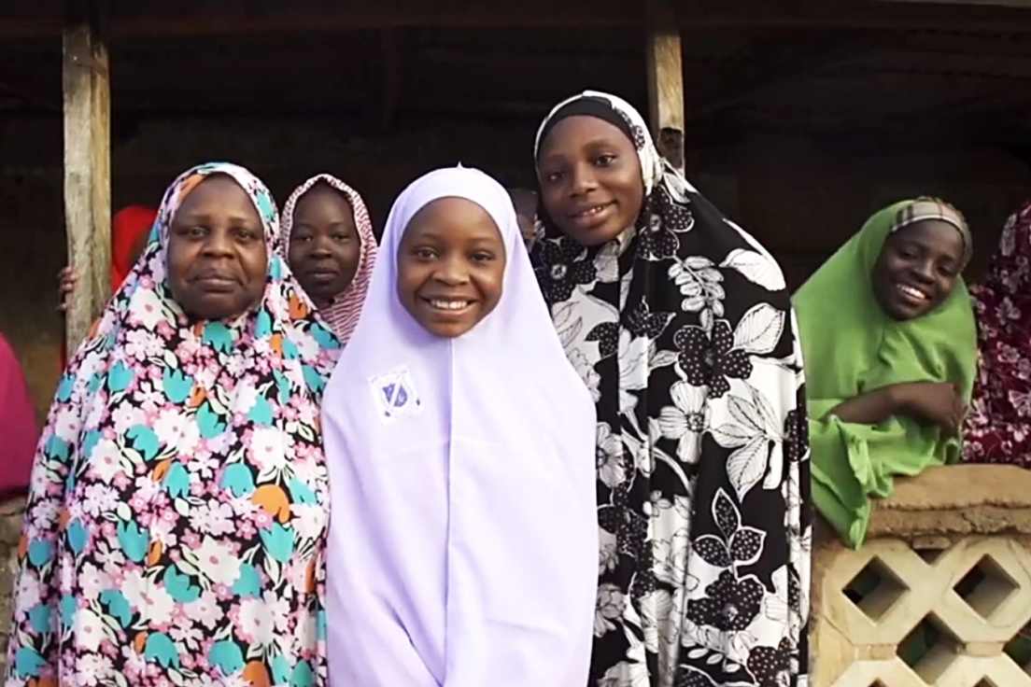
MODULE 05 | Understanding Gender Dynamics to Radicalization, Violent Extremism and Engaging Women and Girls
VIDEO 8 | Naija Girls: Ending violence in Northern Nigeria
By: Search for Common Ground
Original Link:
https://youtu.be/-lOHG37pe3w
Downloadable Link:
The video can be downloaded here.
Arabic Subtitles:
Advanced
(recommended for use with downloaded versions)
Basic
(recommended for use with YouTube)
Instructions on using these subtitles are
available here.
13

Slide 14
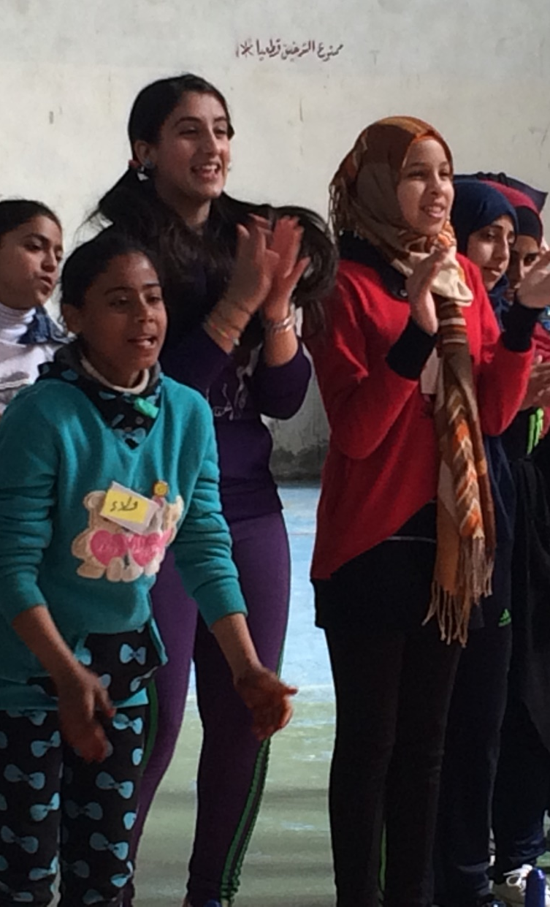
MODULE 05 | Understanding Gender Dynamics to Radicalization, Violent Extremism and Engaging Women and Girls
Risks from engaging women and girls:
Women may only be incorporated as participants in programs and activities, rather than as leaders.
Women may be only expected to work on activities that only target women or “women’s issues” rather than the full scope of activities.
Countering violent extremism policies may risk the securitization or instrumentalization of women’s concerns.
14

Slide 15
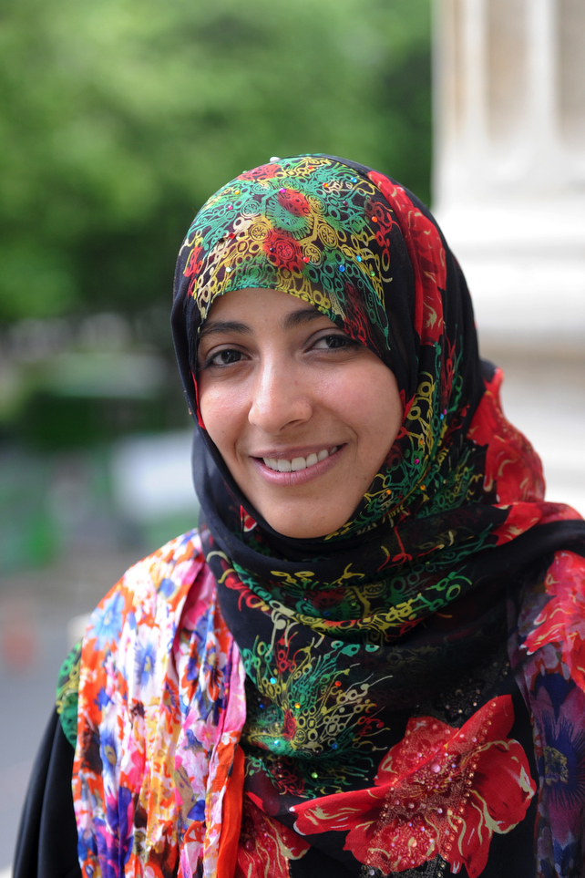
University of Salford/CC BY 2.0
MODULE 05 | Understanding Gender Dynamics to Radicalization, Violent Extremism and Engaging Women and Girls
Risks from engaging women and girls:
Women and girls may face unique security risks because their empowerment is seen particularly threatening to violent extremist groups or traditional male leaders.
The parents or the male relatives of women and girls may sometimes resist women and girls’ full participation.
15

Slide 16
MODULE 05 | Understanding Gender Dynamics to Radicalization, Violent Extremism and Engaging Women and Girls
Good practices for engaging women and girls:
Include women and girls and gender mainstreaming in all parts of programming, including design, implementation, and evaluation.
Involve men and boys in mainstreaming gender.
Build the capacity of women and girls to contribute safely and productively.
Support women-led organizations’ access to resources and opportunities to undertake countering violent extremism activities.
Ensure that efforts counter women and girls’ involvement in violent extremism, including by identifying gender dynamics in radicalization.
16

Slide 17

MODULE 05 | Understanding Gender Dynamics to Radicalization, Violent Extremism and Engaging Women and Girls
KEY TAKEWAYS
Gender is an important factor in understanding and countering violent extremism for both men and women.
Women and girls supporting and engaging in violent extremism are driven by a variety of motivating factors.
Women and girls are taking diverse roles in violent extremist groups.
17

Slide 18
MODULE 05 | Understanding Gender Dynamics to Radicalization, Violent Extremism and Engaging Women and Girls
KEY TAKEWAYS
Women and girls are required partners in countering the radicalization of both men and women.
Women are already working in the countering violent extremism field.
Women and girls need to be better incorporated at all levels of preventing and countering violent extremism.
18

