Slide 1
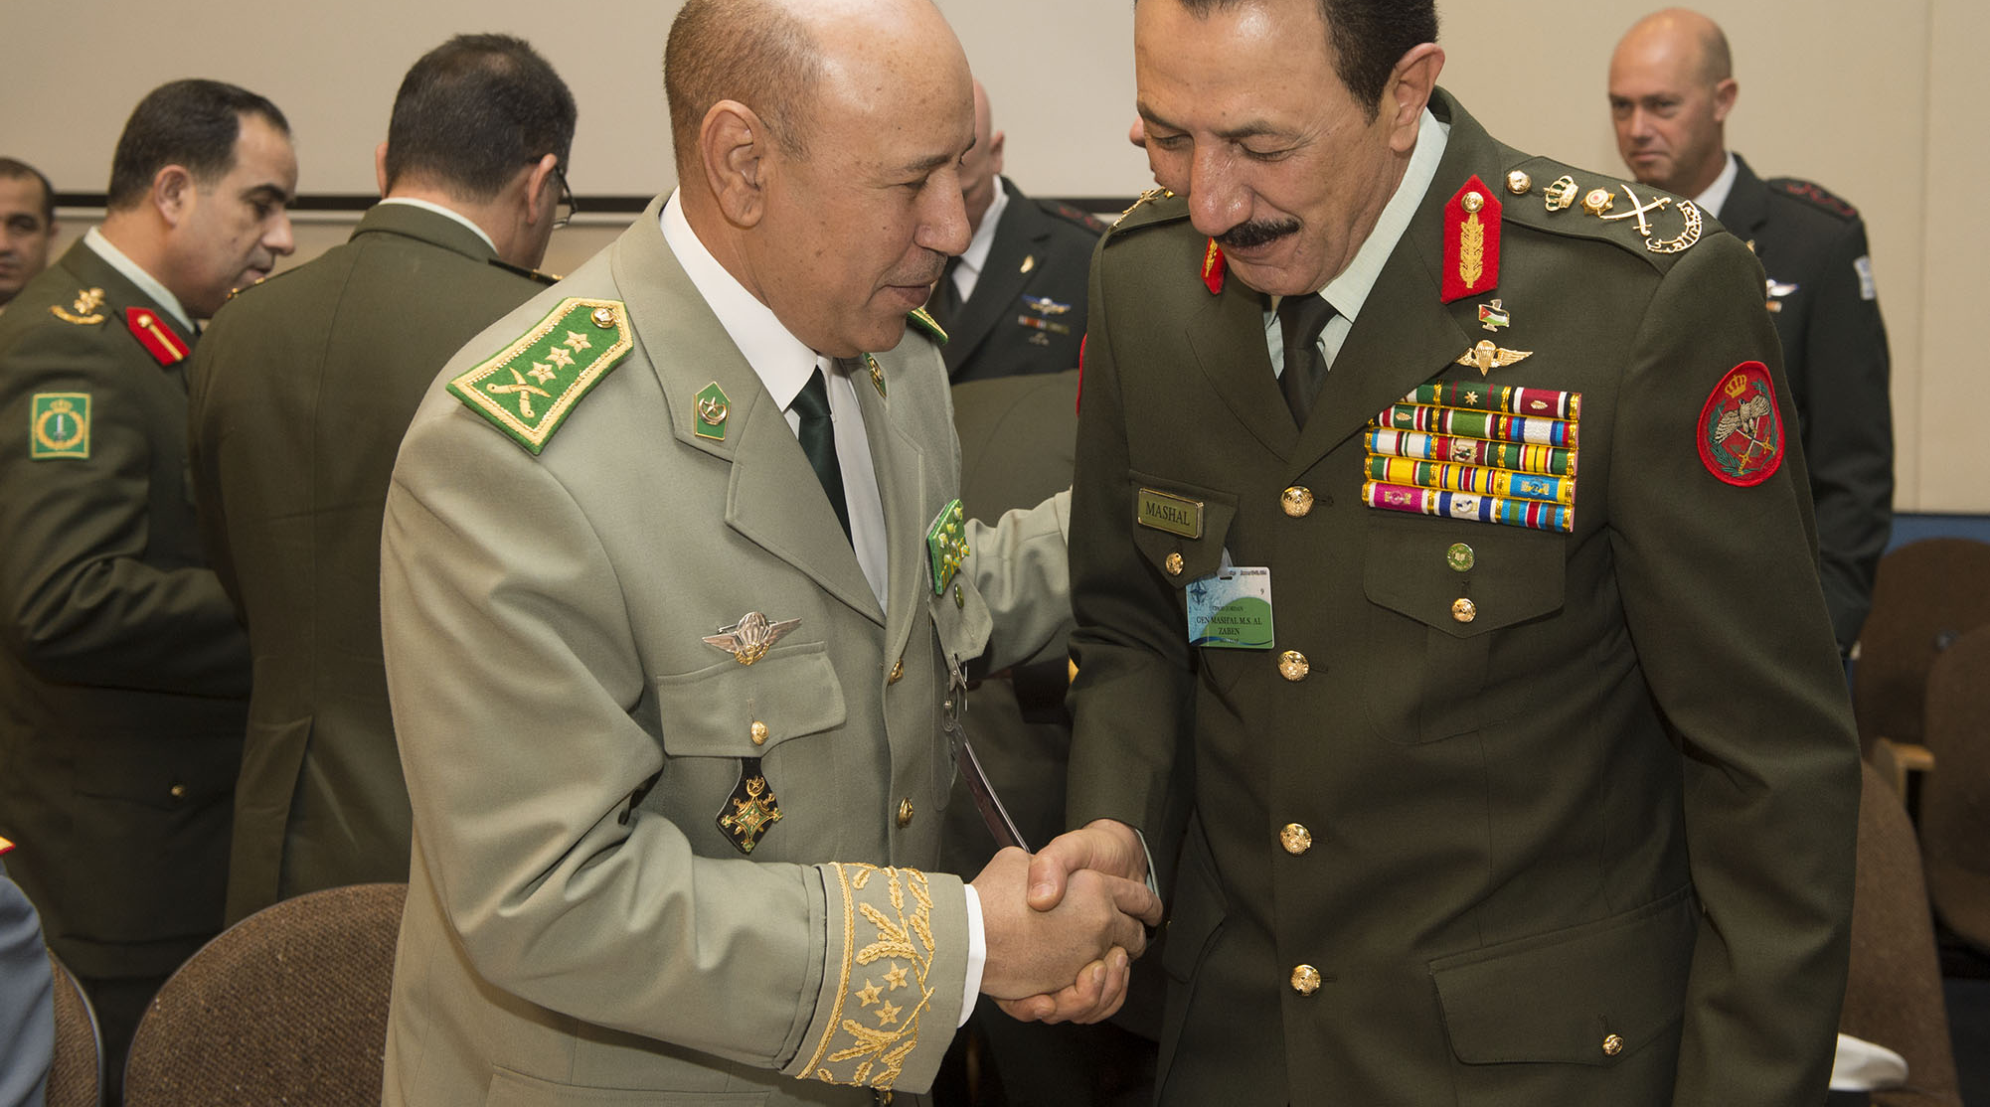



MODULE 04
A Multisectoral Approach to Countering Violent Extremism: Opportunities for Collaboration between Government and Civil Society
NATO/CC BY-NC-ND 2.0

Slide 2

MODULE 04 | A Multisectoral Approach to Countering Violent Extremism: Opportunities for Collaboration Between Government and Civil Society
DO YOU AGREE WITH THE FOLLOWING STATEMENT?
Government agencies alone can solve the problem of drug abuse.
02

Slide 3

Civil society is the broad term for organizations and institutions that act in the interests of citizens —including informal collectives, labor unions, activists, charities, religious institutions, and more.
MODULE 04 | A Multisectoral Approach to Countering Violent Extremism: Opportunities for Collaboration Between Government and Civil Society
03

Slide 4
MODULE 04 | A Multisectoral Approach to Countering Violent Extremism: Opportunities for Collaboration Between Government and Civil Society
ROLES IN COUNTERING VIOLENT EXTREMISM
STRENGTHS
CHALLENGES
Government: (such as ministries, the police, prisons, parliament)
Civil society: (such as organizations, activists, charities, religious institutions)
04

Slide 5

MODULE 04 | A Multisectoral Approach to Countering Violent Extremism: Opportunities for Collaboration Between Government and Civil Society
Did you discover examples of where government strengths and civil society challenges are opposites
or vice versa? How could collaboration between governments and civil society remedy those challenges?
From this exercise, what do you think are the
potential benefits of collaboration in the field of countering violent extremism?
05

Slide 6

MODULE 04 | A Multisectoral Approach to Countering Violent Extremism: Opportunities for Collaboration Between Government and Civil Society
Potential benefits of collaboration:
Multiplies efficiency and impact
Expands the breadth of stakeholders actively engaging in countering violent extremism and expands the toolkit available
Highlights common goals and allows stakeholders to share the burden
Builds shared understandings of the problem and increases communication
Increases system-wide cooperation and builds mutual trust
06

Slide 7
MODULE 04 | A Multisectoral Approach to Countering Violent Extremism: Opportunities for Collaboration Between Government and Civil Society
Why might governments and civil
society not collaborate, and why might collaboration be limited?
07

Slide 8
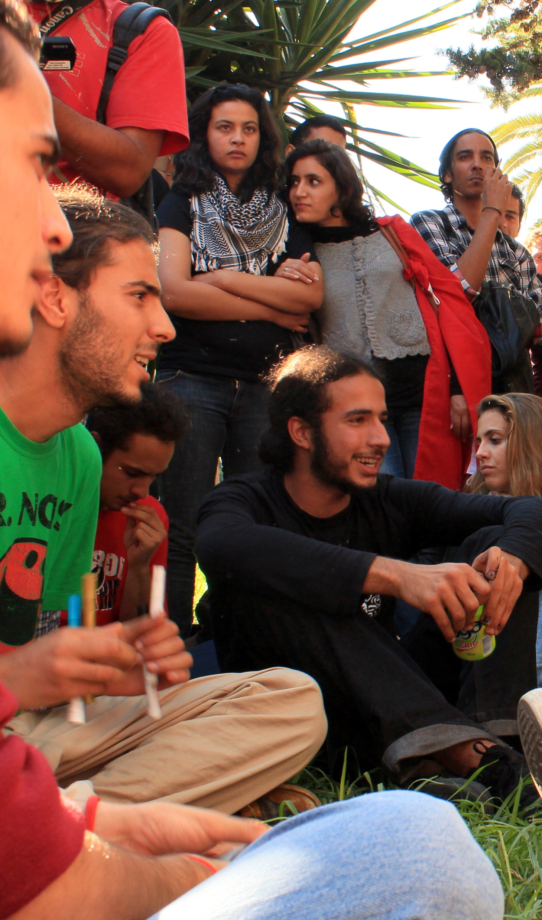
Amine Ghrabi/CC BY-NC 2.0
MODULE 04 | A Multisectoral Approach to Countering Violent Extremism: Opportunities for Collaboration Between Government and Civil Society
Possible reasons for not collaborating on countering violent extremism
Inaccurate information
Incompatible attitudes
Different interests or priorities
Lack the skills or resources to collaborate
08

Slide 9
MODULE 04 | A Multisectoral Approach to Countering Violent Extremism: Opportunities for Collaboration Between Government and Civil Society
Coordination Plan
09

Slide 10
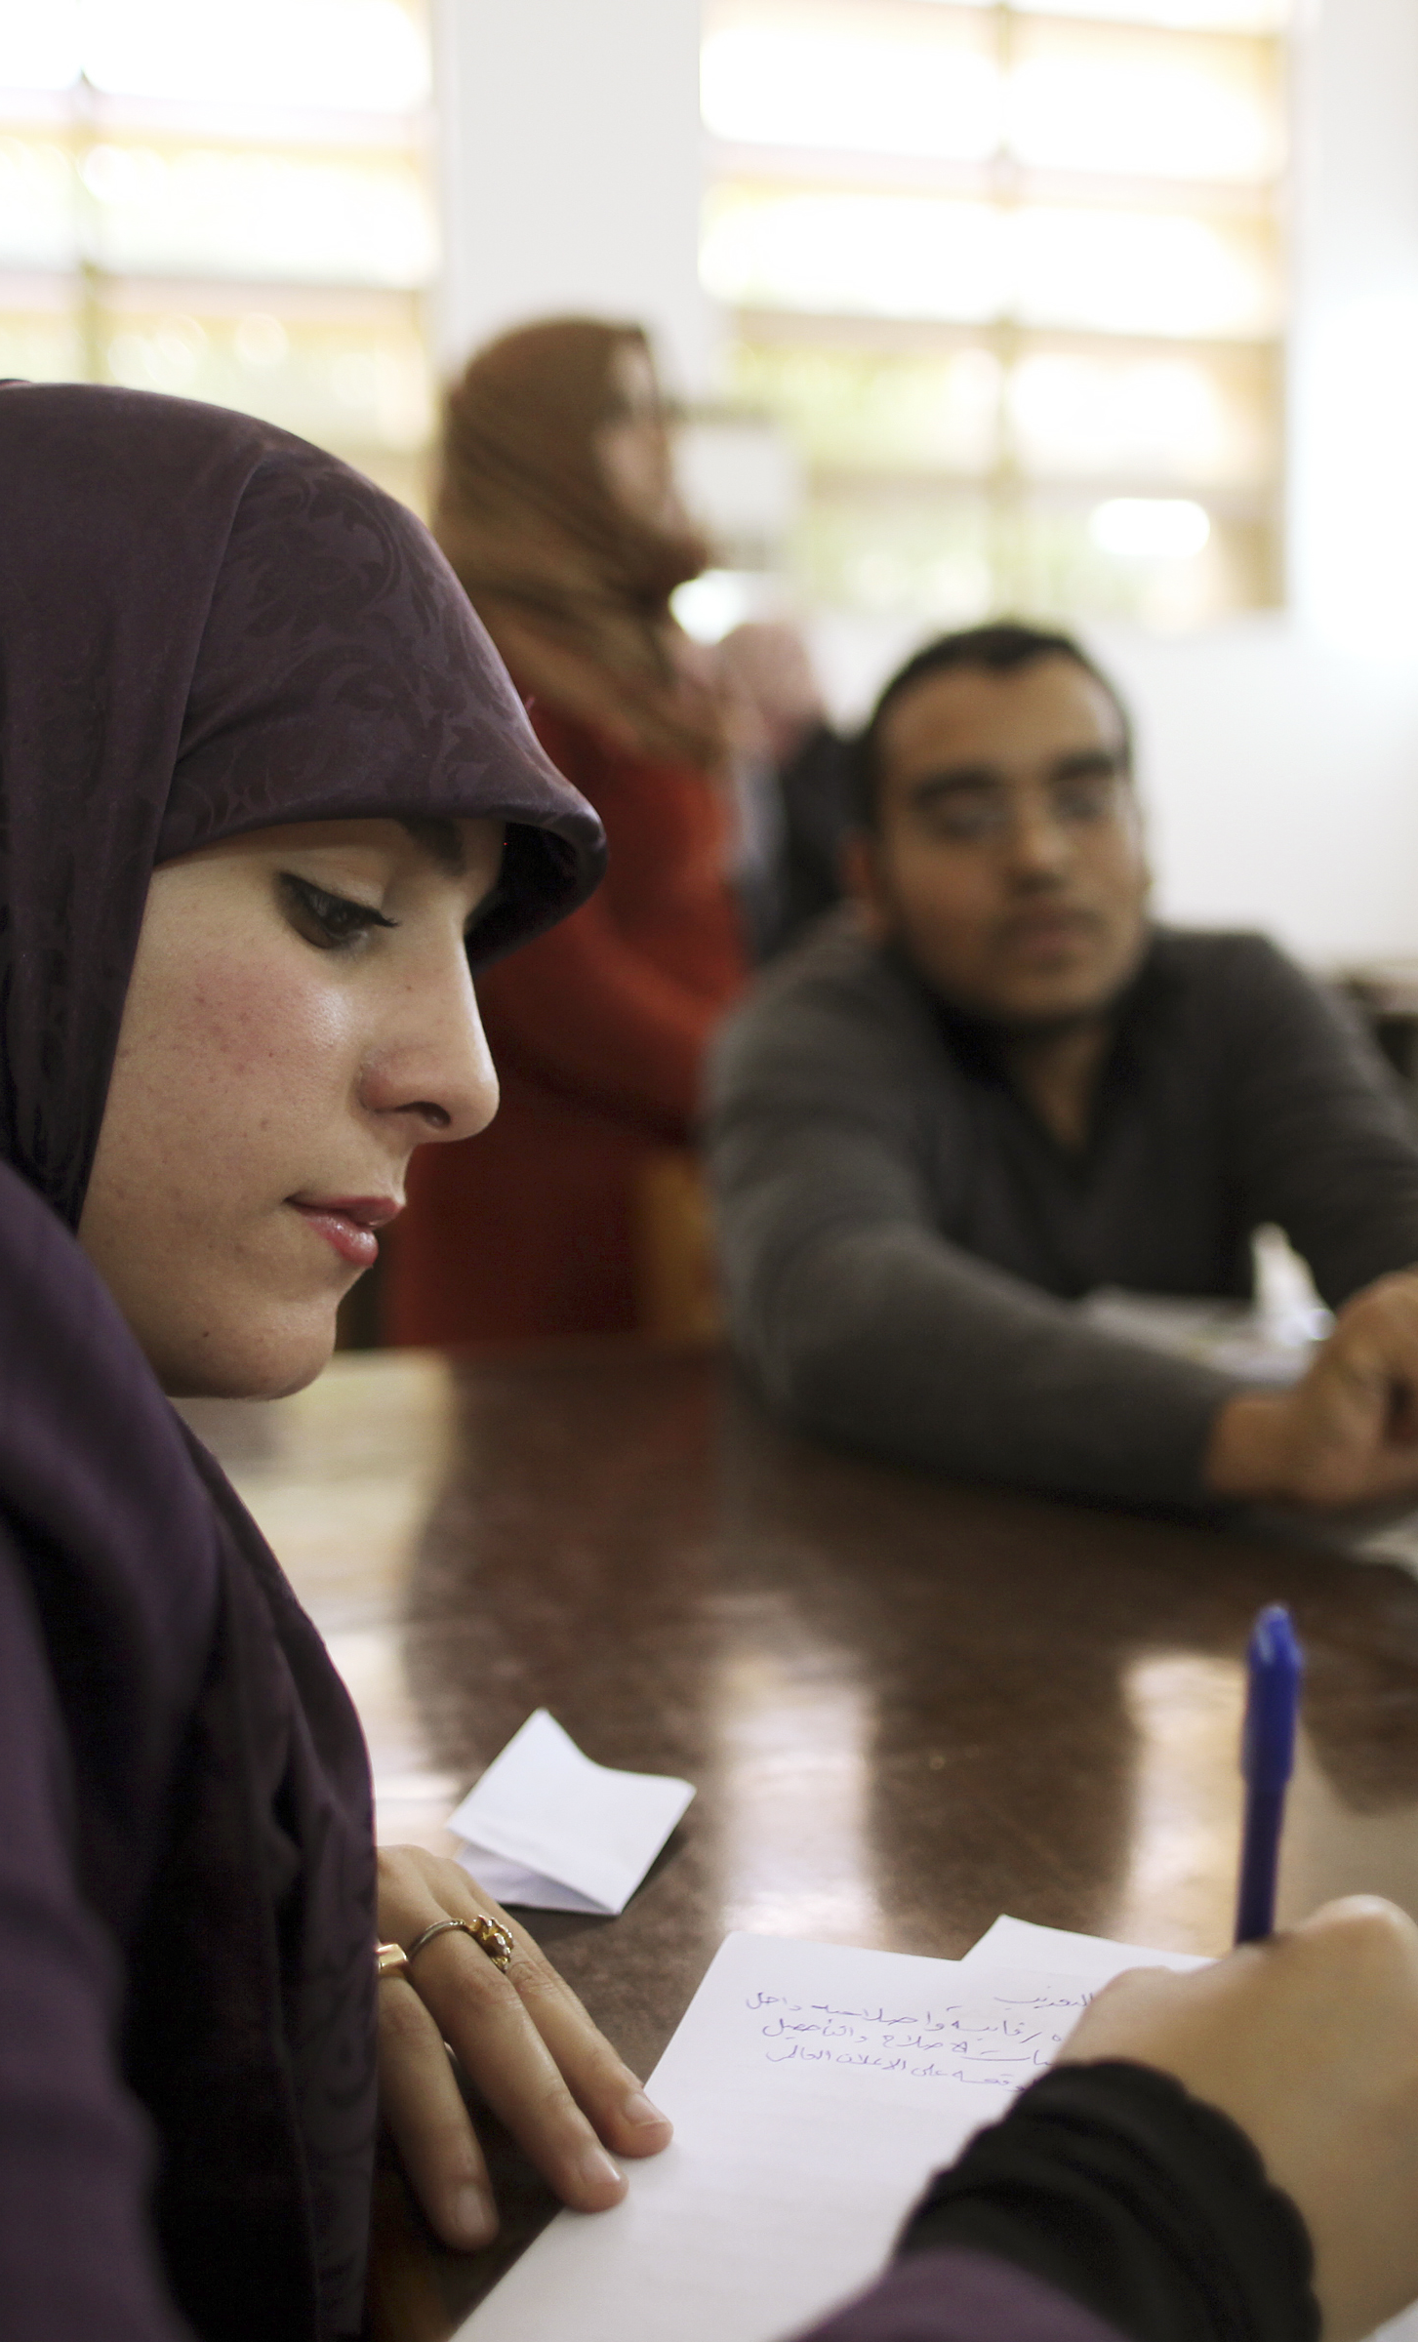
UN Photo/Iason Foounten
MODULE 04 | A Multisectoral Approach to Countering Violent Extremism: Opportunities for Collaboration Between Government and Civil Society
Good practices for effective collaboration:
Formalize collaboration in regional or national strategies or action plans when possible and appropriate.
Be careful using channels to coordinate on countering violent extremism for different purposes.
Do not use programs to prevent and counter violent extremism as a cover for broad law enforcement or intelligence gathering activities.
10

Slide 11
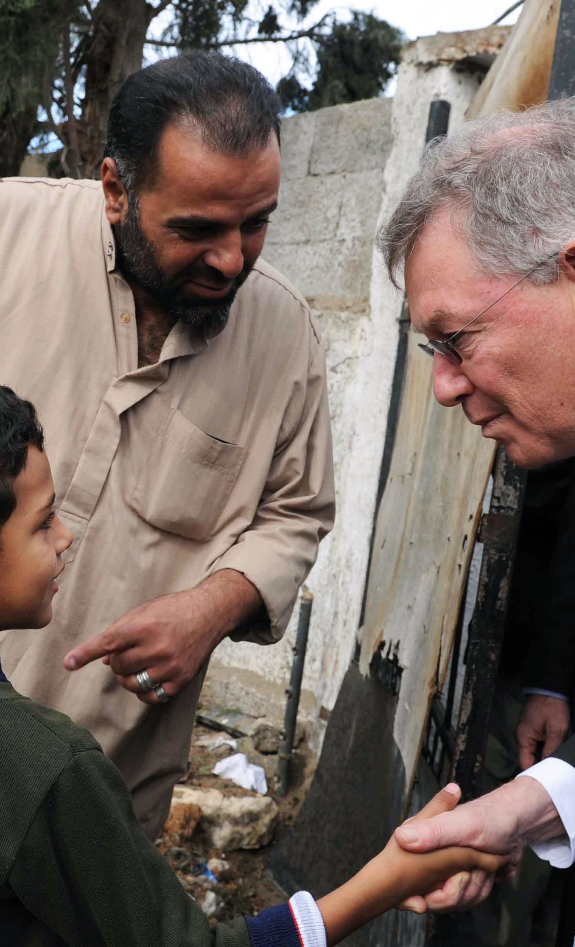
UN Photo/Shareef Sarhan
MODULE 04 | A Multisectoral Approach to Countering Violent Extremism: Opportunities for Collaboration Between Government and Civil Society
Good practices for effective collaboration:
Use broad collaboration to reduce the initial fears to engage.
Respect concerns over confidentiality.
Define roles and responsibilities collectively and discuss limitations.
Recognize that personal collaboration and institutional collaboration are different things that require specific efforts.
11

Slide 12

MODULE 04 | A Multisectoral Approach to Countering Violent Extremism: Opportunities for Collaboration Between Government and Civil Society
KEY TAKEWAYS
Governments and civil society organizations bring unique skill sets and resources to preventing and countering violent extremism.
Collaboration may not be occurring because of trust deficits or a lack of accurate knowledge or skills.
High levels of distrust reduces the number of tools and opportunities for countering violent extremism and may encourage governments to favor security-based approaches.
12

Slide 13
MODULE 04 | A Multisectoral Approach to Countering Violent Extremism: Opportunities for Collaboration Between Government and Civil Society
KEY TAKEWAYS
Some unhealthy government and civil society approaches risk exacerbating tensions or issues that drive violent extremism.
Collaborating in the countering violent extremism space requires long-term commitments built on mutual respect and common understandings of the problem.
13

